Slide 1
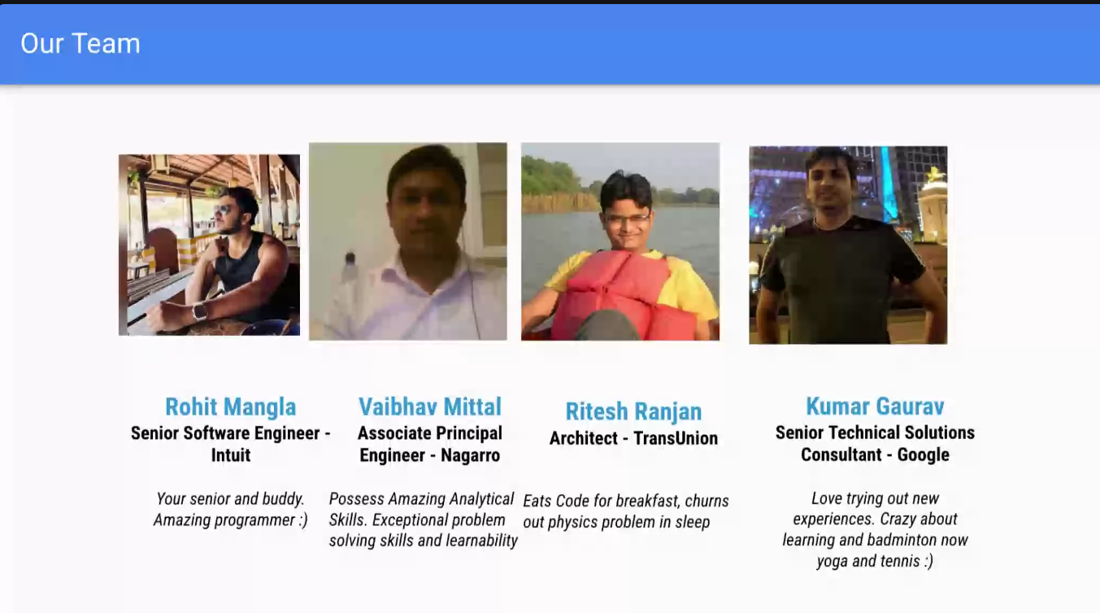
Web dev
Part UCA since 12 years
Student at PEC
Cleared Amazon
clearedSSE team lead
Based in chandigarh , panchkula
Designed
various
System
12-14 Yrs Infosys
joined Google in 2016
Role- Mobile consultant
Developing softwares
that are used in data center
at Google, Google Cloud, Youtube
are their clients or stakeholder.
DSA + SD
DSA + SD
Will come to India on 19 , might come on Mon or Tue

Slide 2
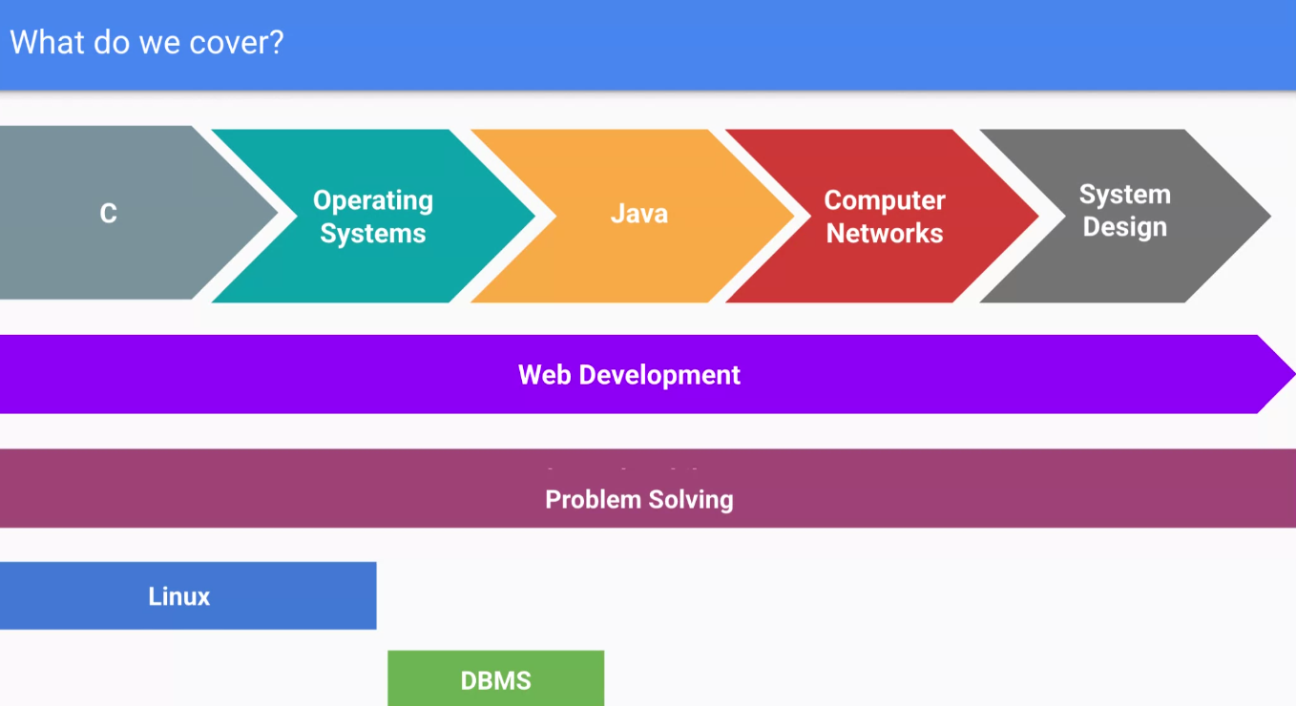
Focus On Basics
At Google , they interview prospective people, strong basics
Placement season starts at Oct- Sept
Consultant roles don’t have good work life balance although they pay more.

Slide 3
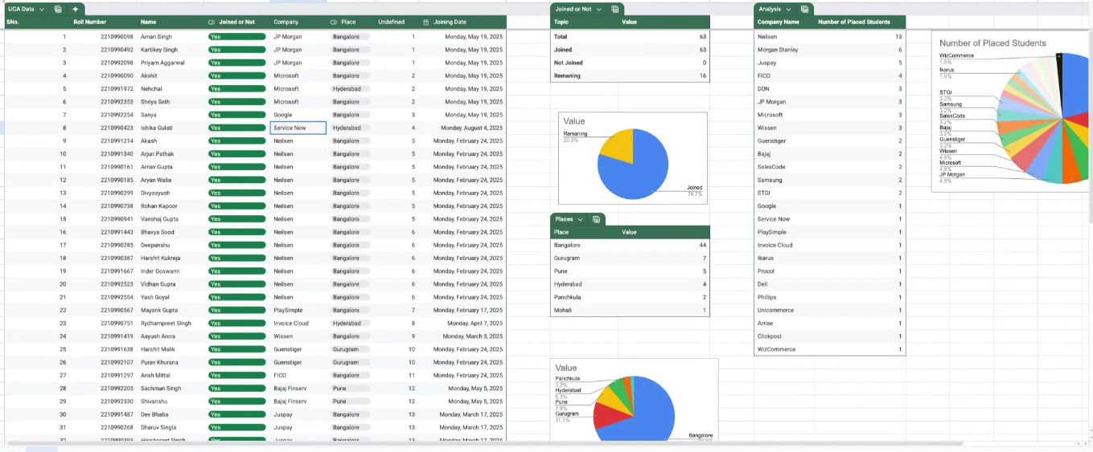
Don’t cram but ask questions.

Slide 4
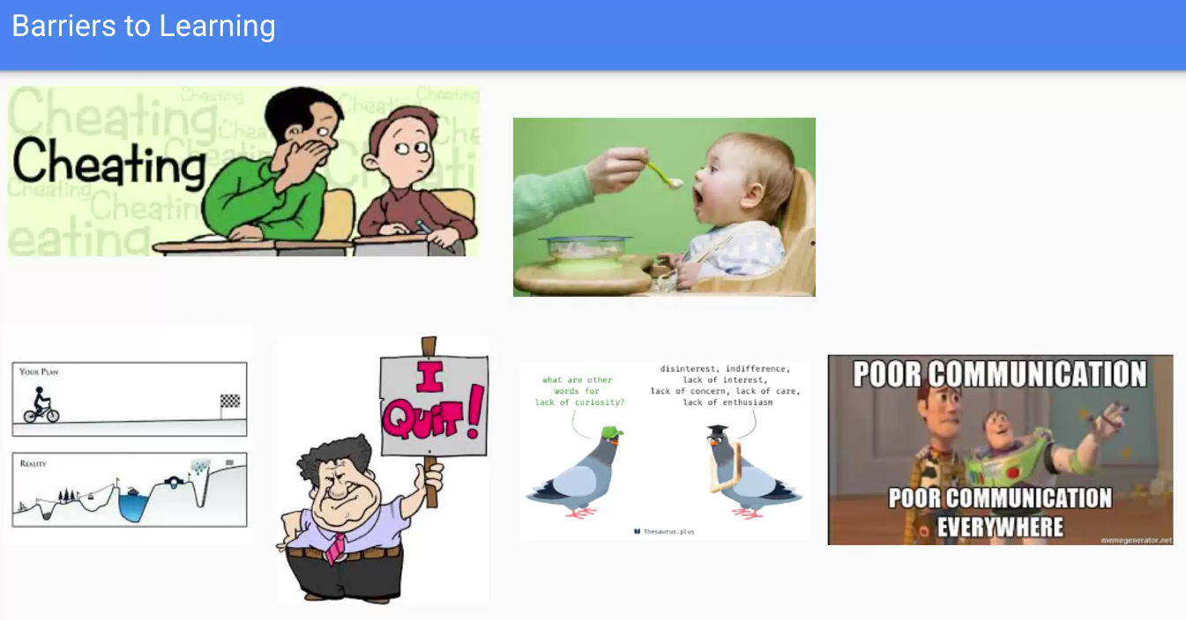
Plan your day
Try to find fun in all the stuggle
Execution without planning will lead to burnout.

Slide 5
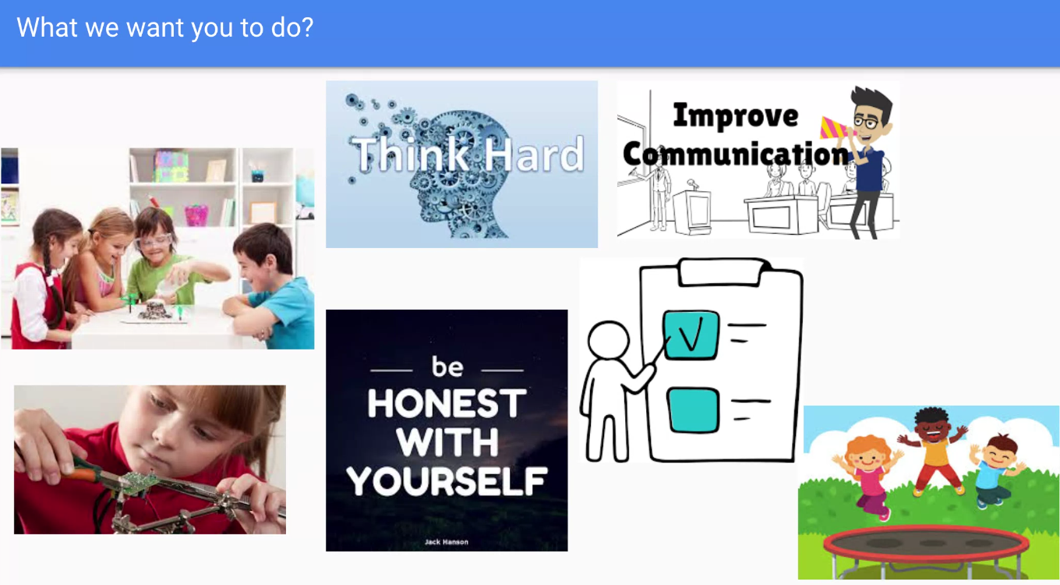
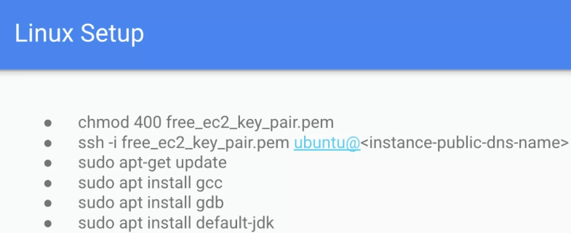

Slide 6
In UCA , we have unstructured learning.
Build your basics strong so that language , platforms doesn’t matter.
In Industry learn about Company Architecture , technologies
CN,OS and DBMS is one subject an engineer must learn.
There was a student in UCA who was very bad at Communcation but proficient in Coding still reached Google (US)
from 4.5 lakh package to Microsoft to Google.
Off campus is much tougher as you to compete all over India

Slide 7
